Slide 1
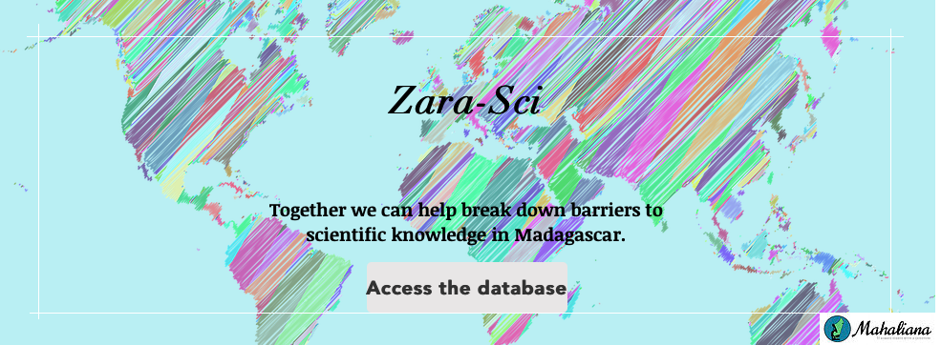
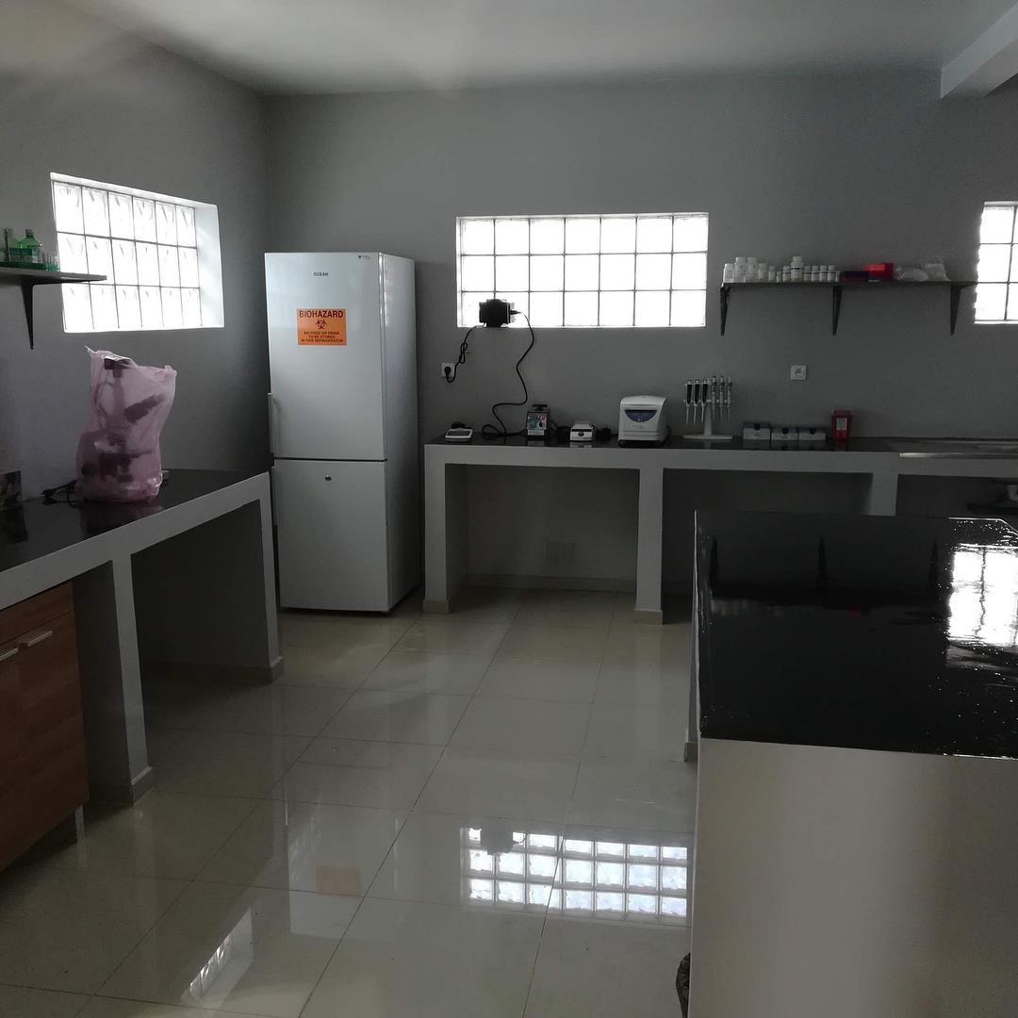
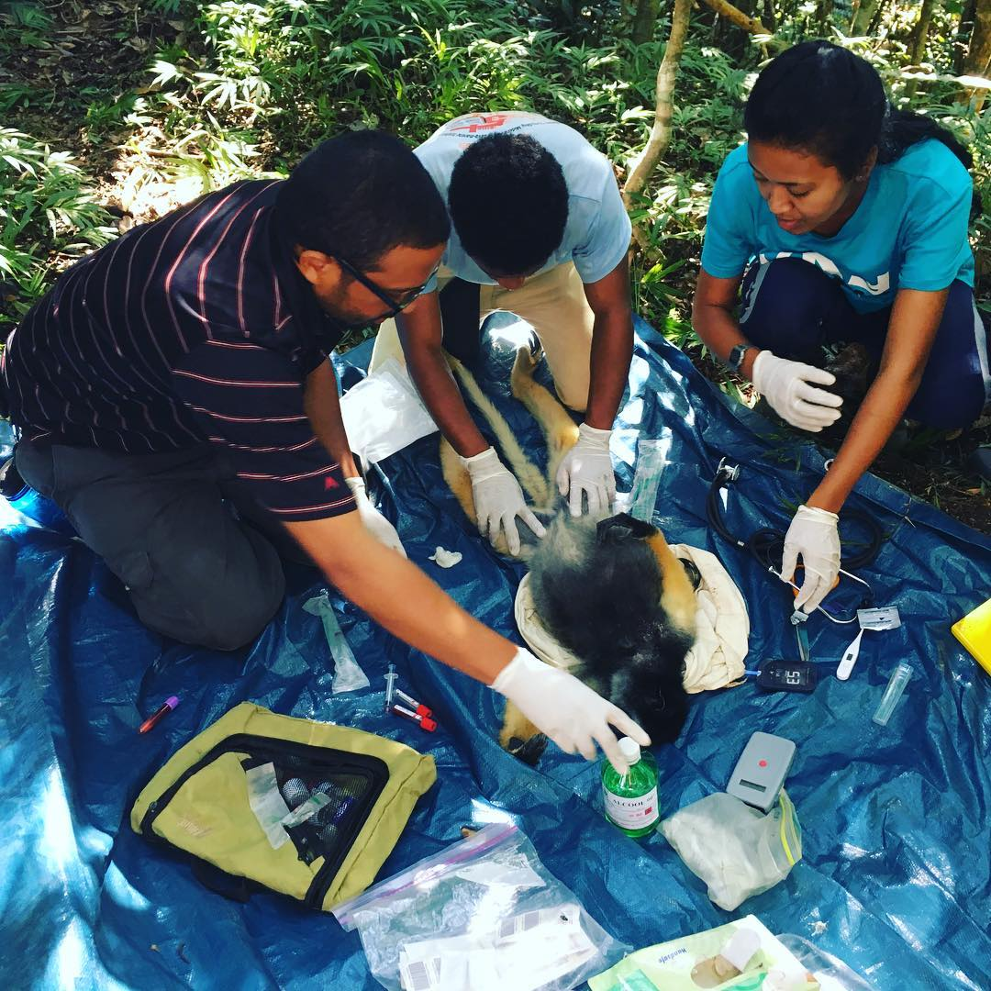
Our mission is to advance conservation science in Madagascar while leveling the playing field for Malagasy scientists.
Organize/facilitate trainings
Create a platform to facilitate networking and collaboration between researchers
Promote conservation science & research in Madagascar
BSL2 Molecular Biology Laboratory
Liz Toomey
Co-Founder; Director of Strategic Planning & Communications
Liz@mahaliana.org | www.mahaliana.org
@mahaliana5
@mahaliana.org
@mahalianalab

Slide 2
1st Women’s March Madagascar
January 19, 2019
Ranomafana

Slide 3
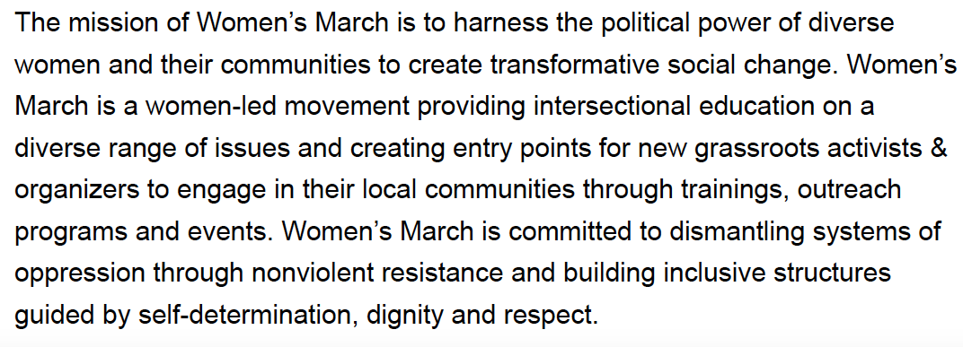
What is the Women’s March?
The first Women’s March was a worldwide protest that occurred on January 21, 2017 following the inauguration of Donald Trump.
An estimated 7 million people participated in ~670 protests worldwide. It has become a global movement, with the 3rd anniversary happening this weekend!

Slide 4
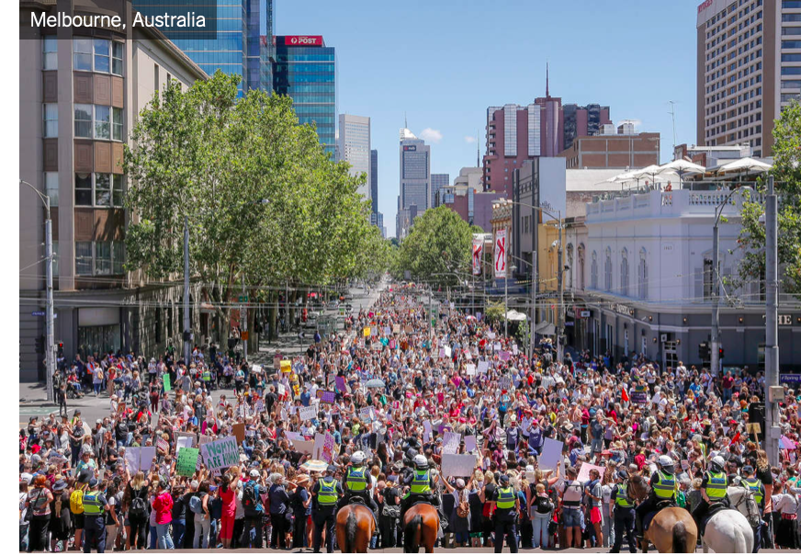
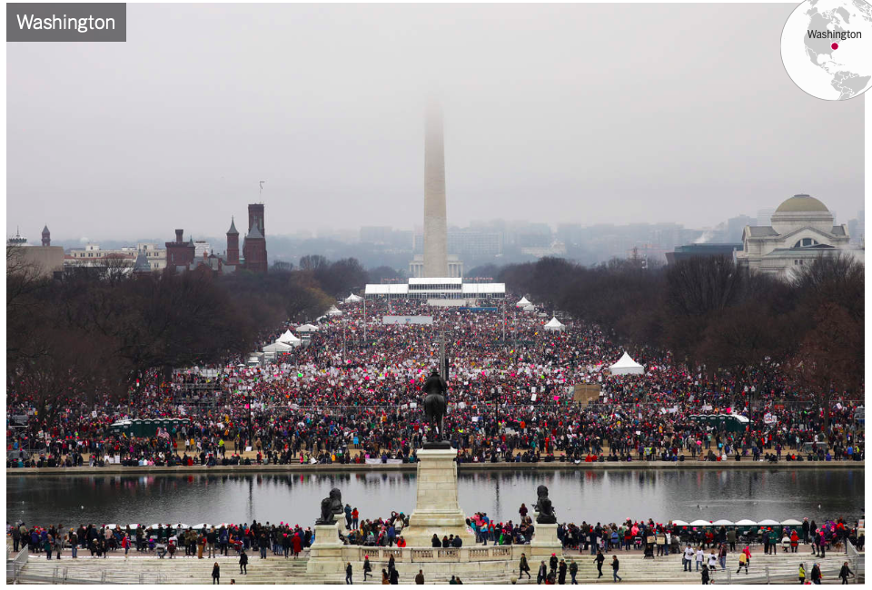
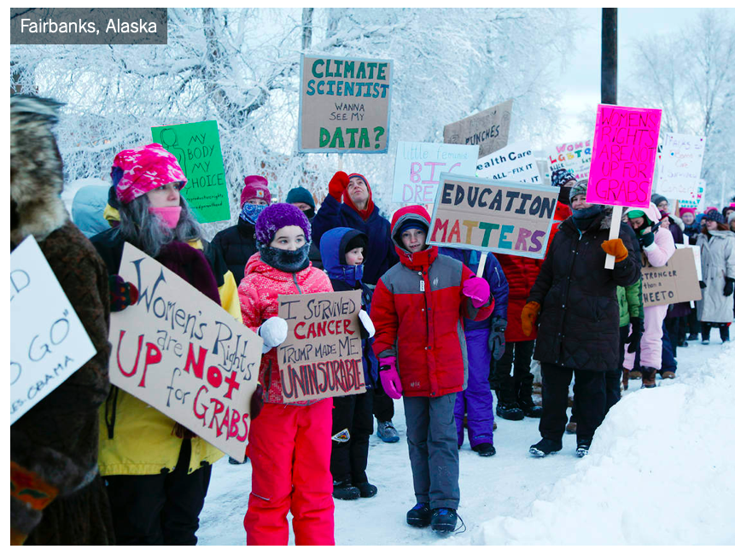
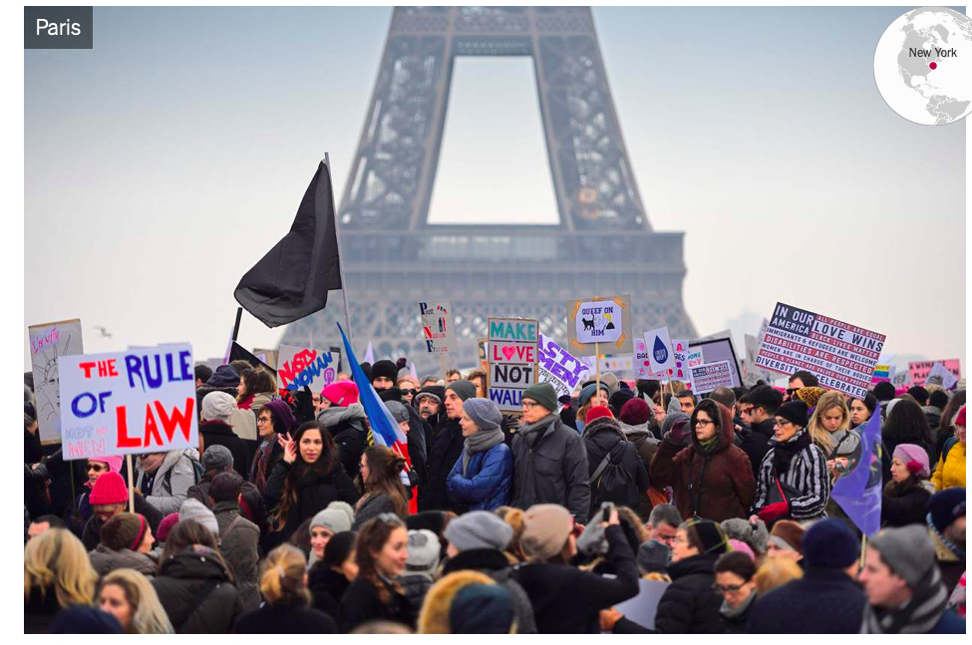
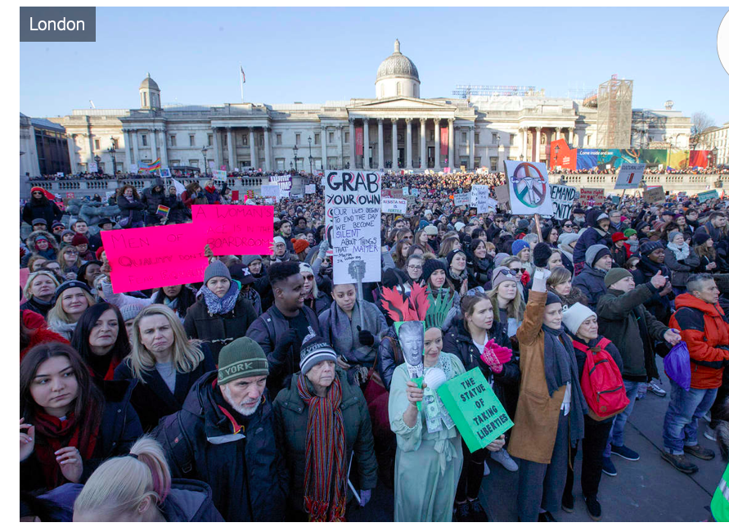
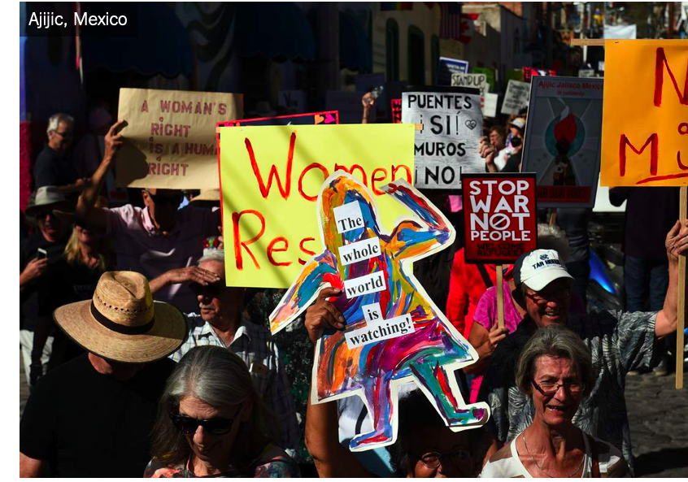
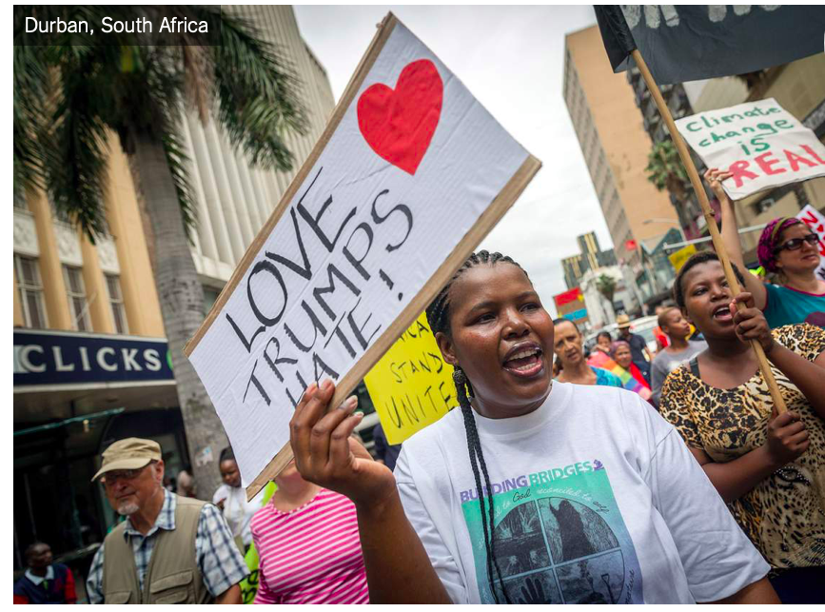
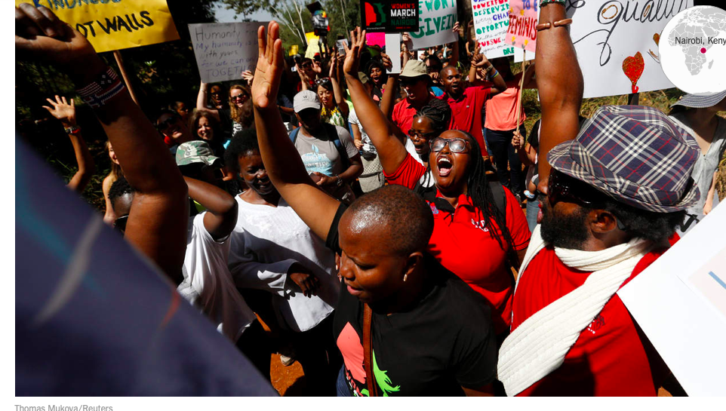

Slide 5
Global Unity Principles

Slide 6
Women’s March Antananarivo Chapter
https://womensmarchglobal.org/chapters/

Slide 7
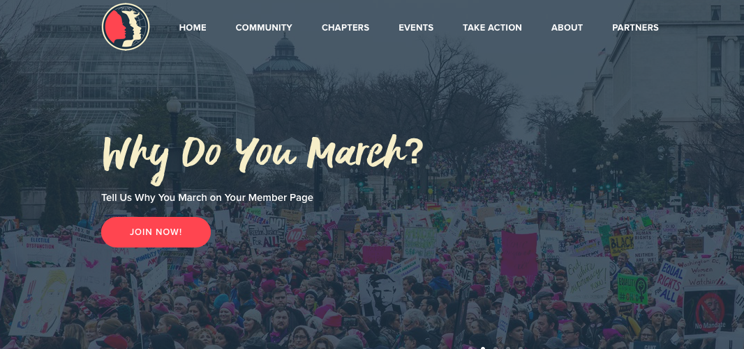
Saturday, January 19, 2019
1pm Gather at CVB to distribute T-shirts, make signs
~2pm March into town to a TBD location for snacks & speeches/discussion!

Slide 8
What is Democracy? How can we, as regular citizens, participate in democracy?
What changes would you like to see in your community, your country, or the world?
What can I do, what actions can I take, to help make these changes?
Why do you march?

